Slide 1
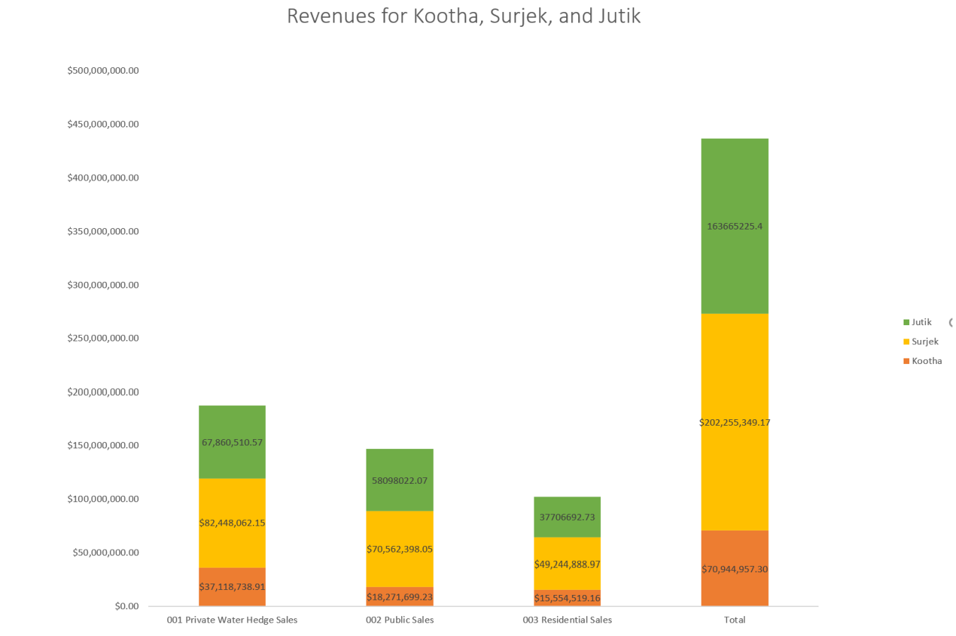
The graph clearly shows that Surjek unit has the highest revenue. The second highest revenue is for Jutik unit, and Kootha has the lowest revenue

Slide 2
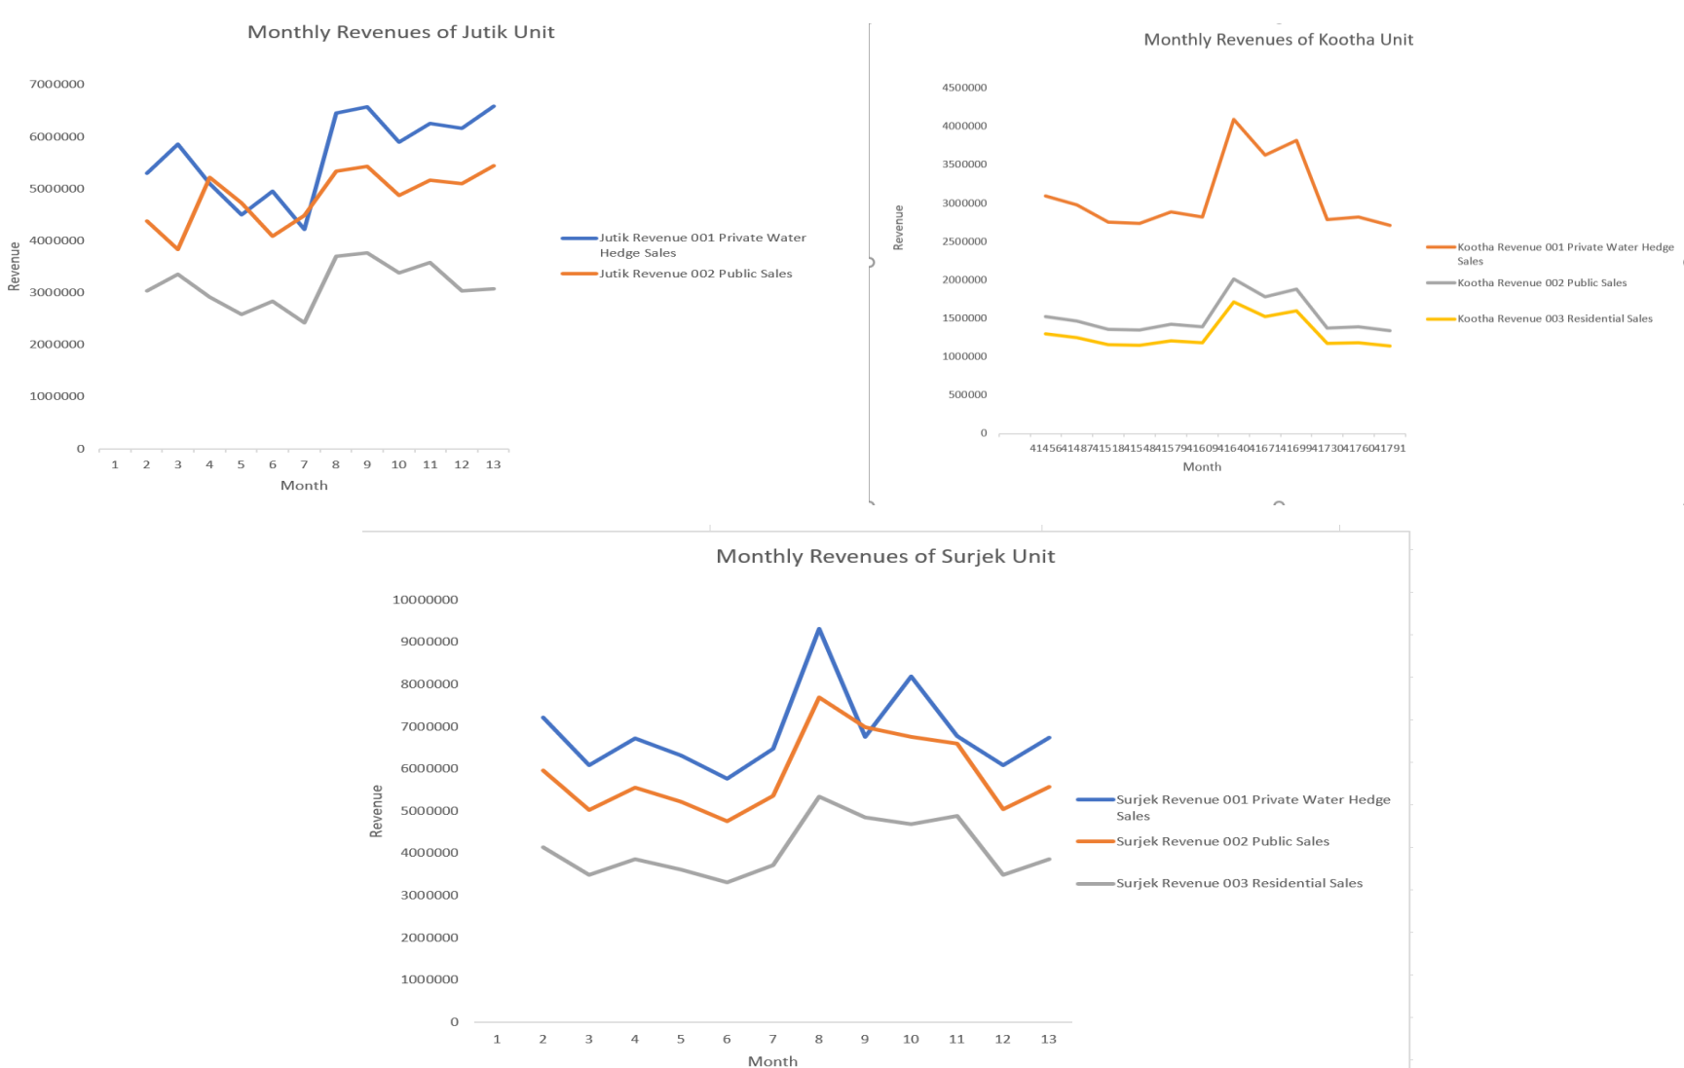
These three charts show that the revenue for Private Water Hedge Sales is higher than Public sales and Residential sales for all units. The second highest revenue is for Public Sales and the lower revenue is for Residential unit
Note: This refers to the Total Sales for all 3 Units (Kootha, Surjek and Jutik)

Slide 3
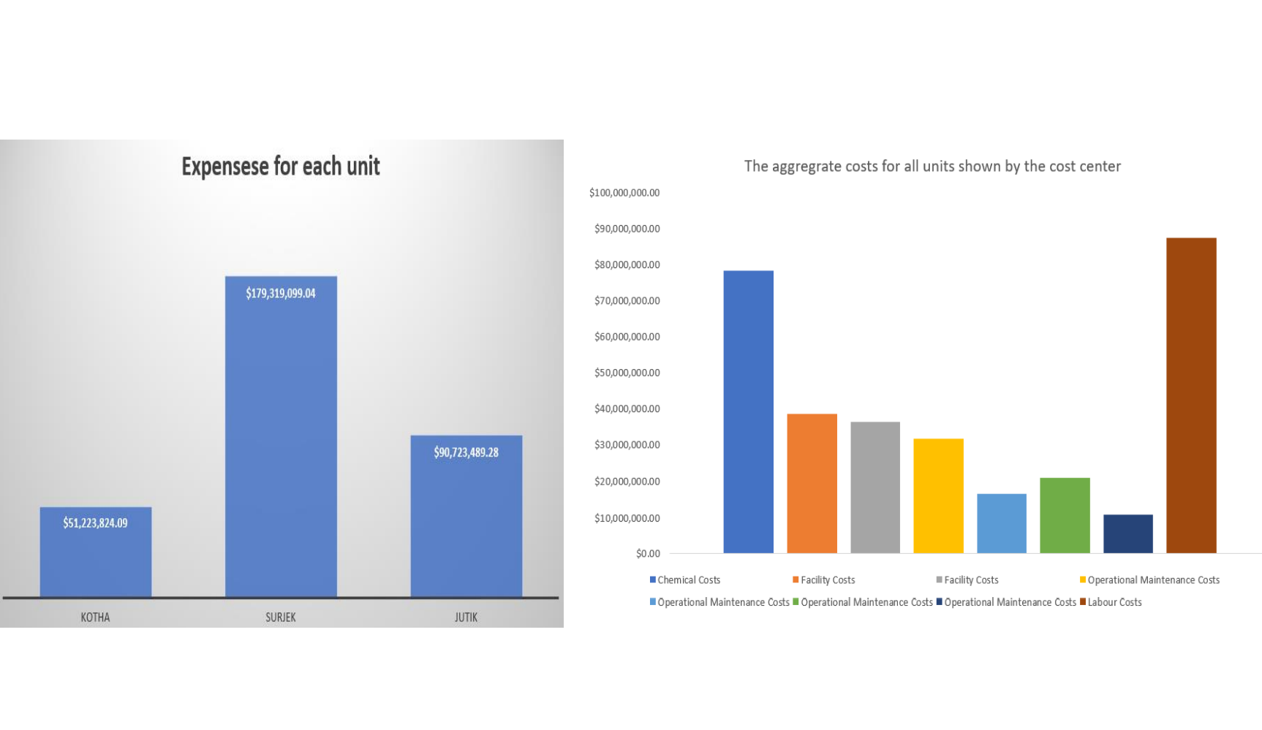
The first chart shows that Surjek unit has the highest expenses and Jutik has second highest expenses. Finally, Kootha has the least expenses. The secondary chart demonstrates that labour costs have the highest expenses. The second highest expenses is for chemical costs.

Slide 4
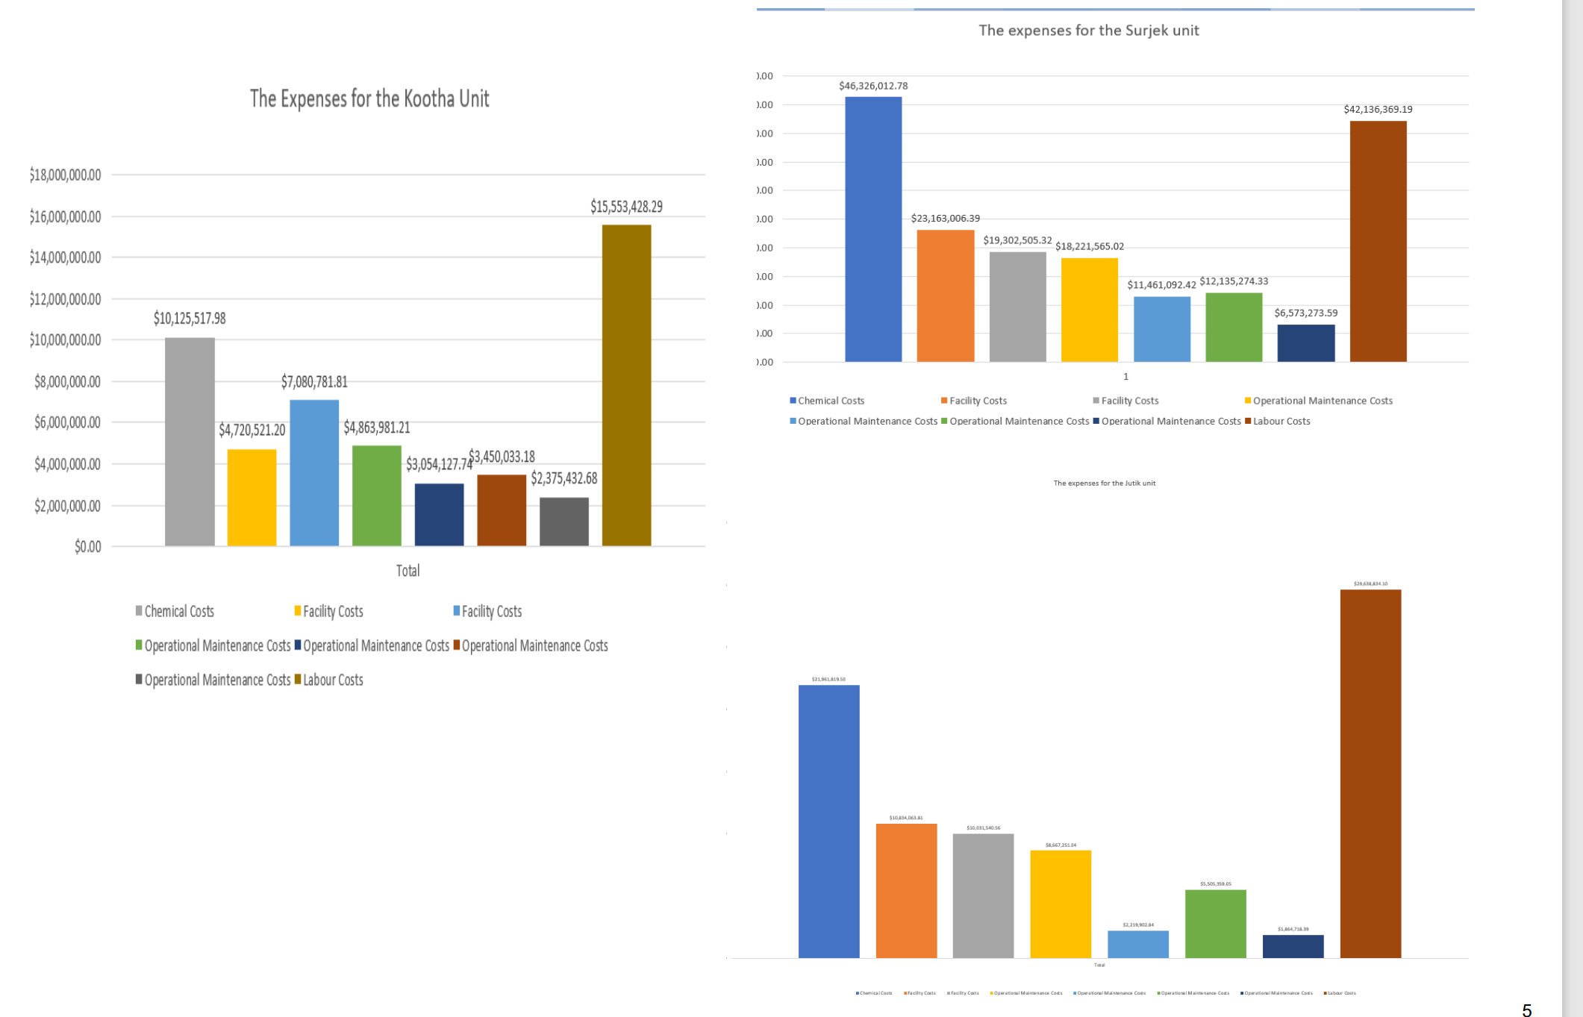
These three charts demonstrate that chemical costs are higher than labour costs for the Surjek unit. However, labour costs are the highest in both Kootha and Jutik units.

Slide 5
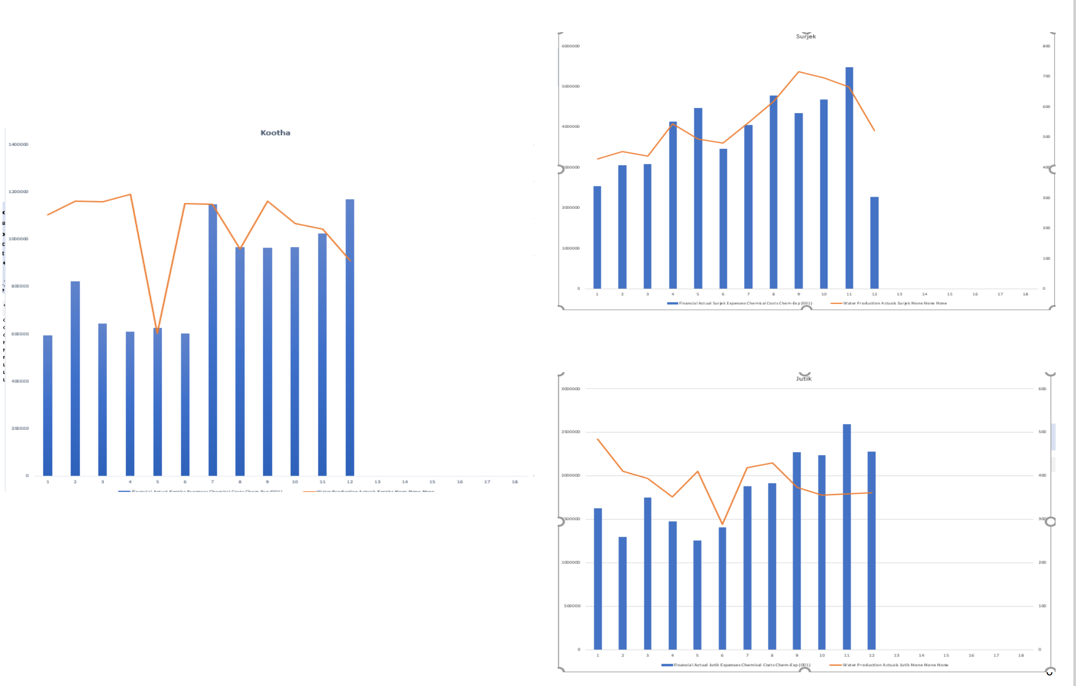
Based on the combo chart, there appears to by a relationship between the chemical expenditure and water production. This is more visible for the Surjek unit. For the Surjek unit, it is apparent that water production increases with the usage of chemicals and vice versa.

Slide 6
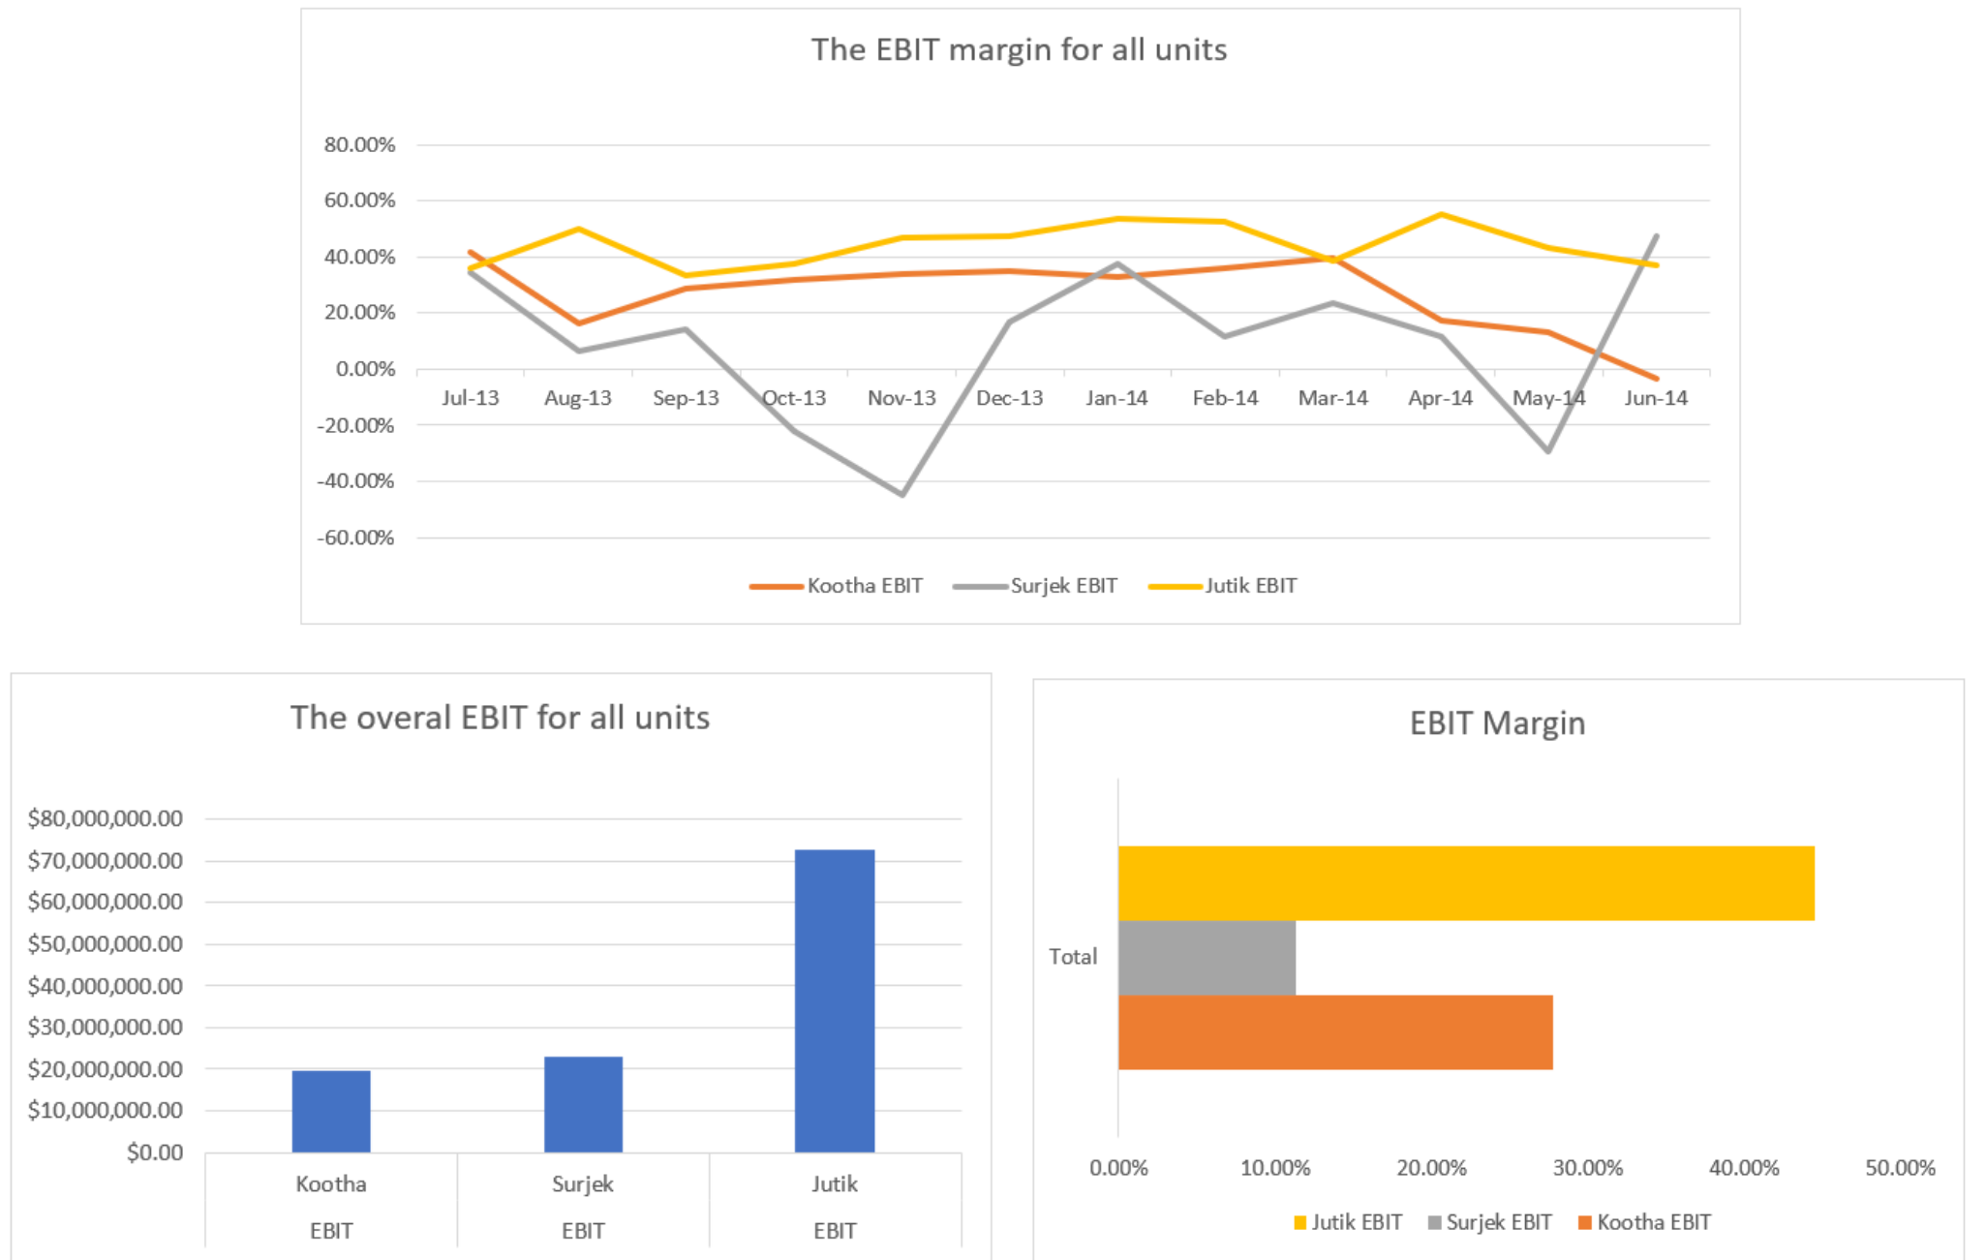
Concluding our analysis, Jutik has the highest overall EBIT contributions , followed by Surjek , and lastly Kootha. However, from an EBIT Margin (%) perspective, Kootha has a higher margin than that of Surjek, indicative of a lower revenue-to-expense ratio.
Note:¹ We can clearly see for Surjek over the October, November and May Periods – expenses were far higher than revenues which contributed to this lower revenue-to-expense ratio.

